Slide 1
Intro to Cryptography
ITIS 6200/8200 Fall 2023

Slide 2
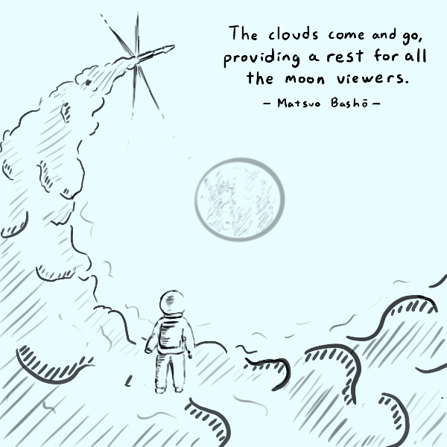
Announcements
See calendar for latest OH schedule

Slide 3
Cunning Plan Today: Cryptography
Introduction to Cryptography
What is cryptography?
Definitions
Building blocks of cryptography
A brief history of cryptography

Slide 4
What is cryptography?

Slide 5
What is cryptography?
Older definition: The study of secure communication over insecure channels
Newer definition: Provide rigorous guarantees on the security of data and computation in the presence of an attacker
Not just confidentiality but also integrity and authenticity (we’ll see these definitions today)
Modern cryptography involves a lot of math

Slide 6
Definitions

Slide 7
Meet Alice, Bob, Eve, and Mallory
Alice and Bob: The main characters trying to send messages to each other over an insecure communication channel
Carol and Dave can also join the party later
Eve: An eavesdropper who can read any data sent over the channel
Mallory: A manipulator who can read and modify any data sent over the channel

Slide 8
Meet Alice, Bob, Eve, and Mallory
We often describe cryptographic problems using a common cast of characters
One scenario:
Alice wants to send a message to Bob.
However, Eve is going to eavesdrop on the communication channel.
How does Alice send the message to Bob without Eve learning about the message?
Another scenario:
Bob wants to send a message to Alice.
However, Mallory is going to tamper with the communication channel.
How does Bob send the message to Alice without Mallory changing the message?
Notes:
Passive attacker versus Active attacker

Slide 9
Three Goals of Cryptography
In cryptography, there are three main properties that we want on our data
Confidentiality: An adversary cannot read our messages.
Integrity: An adversary cannot change our messages without being detected.
Authenticity: I can prove that this message came from the person who claims to have written it.
Integrity and authenticity are closely related properties…
Before I can prove that a message came from a certain person, I have to prove that the message wasn’t changed!
… but they’re not identical properties
Later we’ll see some edge cases

Slide 10
Keys
The most basic building block of any cryptographic scheme: The key
We can use the key in our algorithms to secure messages
Two models of keys:
Symmetric key model: Alice and Bob both know the value of the same secret key.
Example: AES encryption
Asymmetric key model: Everybody has two keys, a secret key and a public key.
Example: RSA encryption

Slide 11
Security Principle: Kerckhoff’s Principle
This principle is closely related to Shannon’s Maxim
Don’t use security through obscurity. Assume the attacker knows the system.
Kerckhoff’s principle says:
Cryptosystems should remain secure even when the attacker knows all internal details of the system
The key should be the only thing that must be kept secret
The system should be designed to make it easy to change keys that are leaked (or suspected to be leaked)
If your secrets are leaked, it is usually a lot easier to change the key than to replace every instance of the running software
Our assumption: The attacker knows all the algorithms we use. The only information the attacker is missing is the secret key(s).

Slide 12
Confidentiality
Confidentiality: An adversary cannot read our messages.
Analogy: Locking and unlocking the message
Alice uses the key to lock the message in a box
Alice sends the message (locked in the box) over the insecure channel
Eve sees the locked box, but cannot access the message without the key
Bob receives the message (locked in the box) and uses the key to unlock the message
Alice
Key
Insecure Channel
Key
Bob
Message
Lock
Message in locked box
Unlock
Message

Slide 13
Confidentiality
Schemes provide confidentiality by encrypting messages
Alice uses the key to encrypt the message: Change the message into a scrambled form
Alice sends the encrypted message over the insecure channel
Eve sees the encrypted message, but cannot figure out the original message without the key
Bob receives the encrypted message and uses the key to decrypt the message back into its original form
Alice
Key
Insecure Channel
Key
Bob
Message
Encryption Algorithm
Encrypted Message
Decryption Algorithm
Message

Slide 14
Confidentiality
Plaintext: The original message
Ciphertext: The encrypted message
Alice
Key
Insecure Channel
Key
Bob
Plaintext
Encryption Algorithm
Ciphertext
Decryption Algorithm
Plaintext

Slide 15
Integrity (and Authenticity)
Integrity: An adversary cannot change our messages without being detected.
Analogy: Adding a seal on the message
Alice uses the key to add a special seal on the message (e.g. puts tape on the envelope)
Alice sends the message and the seal over the insecure channel
If Mallory tampers with the message, she’ll break the seal (e.g. break the tape on the envelope)
Without the key, Mallory cannot create her own seal
Bob receives the message and the seal and checks that the seal has not been broken
Alice
Key
Insecure Channel
Key
Bob
Message
Create Seal
Message
Check Seal
Message
Seal

Slide 16
Integrity (and Authenticity)
Schemes provide integrity by adding a tag or signature on messages
Alice uses the key to generate a special tag for the message
Alice sends the message and the tag over the insecure channel
If Mallory tampers with the message, the tag will no longer be valid
Bob receives the message and the tag and checks that the tag is still valid
More on integrity in a future lecture
Alice
Key
Insecure Channel
Key
Bob
Message
Create Tag
Message
Check Tag
Message
Tag

Slide 17
Threat Models (Types of Cryptanalysis)
Ciphertext only
Attackers only have ciphertext, need to decrypt it
Known-plaintext
Attackers know some ciphertext and its corresponding plaintext, needs to decrypt some other cyphertext
Chosen-plaintext
Attackers can get any ciphertext they want encrypted, and need to decrypt some specific cyphertext
In this class, we often use the chosen plaintext attack model
Notes:
Cipher-text
Known plaintext attack:
Chosen plaintext attack: try to get the key or a method to decrypt

Slide 18
Building Blocks of Cryptography

Slide 19
Cryptography Roadmap
 | Symmetric-key | Asymmetric-key
Confidentiality | One-time pads Block ciphers with chaining modes (e.g. AES-CBC) Stream ciphers | RSA encryption
Integrity, Authentication | MACs (e.g. HMAC) | Digital signatures (e.g. RSA signatures)
Hash functions
Pseudorandom number generators
Public key exchange (e.g. Diffie-Hellman)
Key management (certificates)
Password management

Slide 20
Modern Cryptography
Modern cryptography is based heavily on mathematics
The math is hard
We won’t cover all the details in this class
Wikipedia is an excellent resource
Notes:
Cipher-text
Known plaintext attack:
Chosen plaintext attack: try to get the key or a method to decrypt

Slide 21
Building Blocks
There are hundreds of security related protocols. Fortunately, only a limited number of building blocks are involved
If secure blocks are put together in a wrong way, the final protocols may be insecure
How to organize these blocks shows the skills of the researchers
Notes:
Cipher-text
Known plaintext attack:
Chosen plaintext attack: try to get the key or a method to decrypt

Slide 22
Block 1: One Way Functions
One way function is easy to calculate in one direction, but not the other.
Given x, easy to get f(x)
Given f(x), even f() is known, still not easy to get a x that satisfies f(x)
Think about the fingerprint of a person
Trap door one way function
Given x, easy to calculate f(x)
Given f(x), difficult to get x
Given f(x) and a secret y, easy to recover x
Think about asymmetric encryption

Slide 23
Block 1: One Way Hash Function
Map a variable-length input string to a fixed length string: fingerprint the file
Easy to get Hash(x) when giving x
Almost impossible to find a x that satisfies Hash(x)
Almost impossible to find two files x and x’ to have the same hash value
Minor change in x, large changes in Hash(x)
Since the hash value is shorter, we have conflict:
We can easily rule out files, but cannot guarantee this is the origin file
Still good enough in courts, like DNA tests

Slide 24
Block 1: One Way Hash Function
Usage of hash function
Timestamp a file and prove that you are the creator (can be used to timestamp the homework)
Hash values of the downloaded files
A commitment that cannot be easily changed
Verify the integrity of the files in a file system
Security problems: how and where to save the hash values
Use a secret key k, do not store k on the computer, use Hash(x, k) to prevent change on the computer: usually called MAC code (message authentication code)

Slide 25
Block 2: Symmetric Cryptography
Steps:
(1) Alice and Bob agree on a key k and an encryption algorithm
(2) Alice calculates E_k (message) and sends the cipher text to Bob
(3) Bob decrypts the message and gets the plaintext
Problems
How to determine the key: must in a secret place
How to convince other people it is from Alice instead of Bob
Number of keys increases fast, not scalable

Slide 26
Block 3: Asymmetric Cryptography
First appeared in 1976, proposed by Diffie and Hellman
Two keys: public key and private key, it is almost impossible to get private key from public key.
A certain kind of trap door one way functions: private key is the secret
Steps:
Alice and Bob agree on a public key encryption algorithm
Bob sends his public key to Alice
Alice calculates E_pubB (message) and sends the cipher text to Bob
Bob decrypts the message with the private key and gets the plaintext

Slide 27
Block 3: Asymmetric Cryptography (continue)
Solve the problem in symmetric crypto methods: the key can be transferred in public
More scalable, easy for multicast
New problems:
How can we make sure it is Bob’s public key
Trusted Third Party
Certificate for the public key
How to guarantee the sender’s identity

Slide 28
Hybrid Crypto Systems
Symmetric methods are fast, easy to implement, but require special attention during key distribution
Asymmetric methods are slow, but more secure
Hybrid:
Using asymmetric method to distribute key
Using symmetric method to encrypt data

Slide 29
Using Hybrid Crypto Systems
Steps
Bob sends Alice his public key
Alice encrypts the session key with this public key and sends to Bob
Both Alice and Bob know the session key and can use it for data traffic
Open question: why should B trust A’s capabilities to generate keys?

Slide 30
Merkle’s Puzzle
Make the life of an eavesdropper difficult
The receiver can randomly choose one message
The eavesdropper has to try almost all of them

Slide 31
Block 4: Digital signature
Signature by symmetric encryption:
TTP will get involved
Who should store the encrypted messages?
How to send to a third party: through TTP again
Signature with asymmetric encryption
Using the private key for signature
If the signature is like “I owe Bob $100”, a timestamp should also be included in the signature to avoid replay attack.

Slide 32
Block 5: Random number
Pseudo random numbers:
Usually will repeat after a long sequence
Must long enough
Real random numbers:
Lava lamp
Earthquake strength or interval

Slide 33
Dual encryption
Let’s assume that everyone in the network has a public-private key pair. Alice wants to send a message to Bob and convince that it is from Alice.
For security communication, i.e., confidentiality and integrity, what shall we do?

Slide 34
Dual encryption
Answer:
Alice should first sign the message with her private key, then use Bob’s public key to encrypt the packet
Reason 1: If Alice’s private key is the outer layer, everyone with Alice’s public key will be able to decrypt it.
Reason 2: never sign a random string that you do not know what it is.
Two pair of public-private keys for everyone: one for encryption, one for digital signature

Slide 35
Symmetric-Key Encryption

Slide 36
Symmetric-Key Encryption
The next few schemes are symmetric-key encryption schemes
Encryption schemes aim to provide confidentiality (but not integrity or authentication)
Symmetric-key means Alice and Bob share the same secret key that the attacker doesn’t know
Don’t worry about how Alice and Bob share the key for now
For modern schemes, we’re going to assume that messages are bitstrings
Bitstring: A sequence of bits (0 or 1), e.g. 11010101001001010
Text, images, etc. can usually be converted into bitstrings before encryption, so bitstrings are a useful abstraction. After all, everything in a computer is just a sequence of bits!

Slide 37
Symmetric-Key Encryption: Definition
A symmetric-key encryption scheme has three algorithms:
KeyGen() → K: Generate a key K
Enc(K, M) → C: Encrypt a plaintext M using the key K to produce ciphertext C
Dec(K, C) → M: Decrypt a ciphertext C using the key K
Alice
Key
Insecure Channel
Key
Bob
Plaintext
Encryption Algorithm
Ciphertext
Decryption Algorithm
Plaintext

Slide 38
Symmetric-Key Encryption: Definition
What properties do we want from a symmetric encryption scheme?
Correctness: Decrypting a ciphertext should result in the message that was originally encrypted
Dec(K, Enc(K, M)) = M for all K ← KeyGen() and M
Efficiency: Encryption/decryption algorithms should be fast: >1 Gbps on a standard computer
Security: Confidentiality
Alice
Key
Insecure Channel
Key
Bob
Plaintext
Encryption Algorithm
Ciphertext
Decryption Algorithm
Plaintext

Slide 39
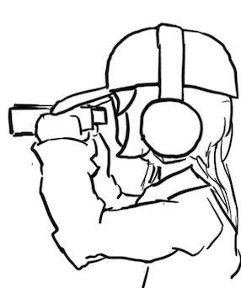
Defining Confidentiality
Recall our definition of confidentiality from earlier: “An adversary cannot read our messages”
This definition isn’t very specific
What if Eve can read the first half of Alice’s message, but not the second half?
What if Eve figures out that Alice’s message starts with “Dear Bob”?
This definition doesn’t account for prior knowledge
What if Eve already knew that Alice’s message ends in “Sincerely, Alice”?
What if Eve knows that Alice’s message is “BUY!” or “SELL” but doesn't know which?

Slide 40
Defining Confidentiality
A better definition of confidentiality: The ciphertext should not give the attacker any additional information about the plaintext.
Let's design an experiment/security game to test our definition:
Eve chooses two messages M0 and M1 of the same length
Alice chooses one message at random Mb, encrypts it, and sends the ciphertext
Eve knows either M0 or M1 was sent, but doesn't know which
Eve reads the ciphertext and tries to guess which message was sent
If the probability that Eve correctly guesses which message was sent is 1/2, then the encryption scheme is confidential
Intuition
If the scheme is confidential, Eve can only guess with probability 1/2, which is no different than if Eve hadn’t sent the ciphertext at all
In other words: the ciphertext gave Eve no additional information about which plaintext was sent!
Notes:
Shafi and Silvio won 2012 Turing award for probabilistic encryption, proving the need for randomization, laying foundations for modern cryptography and much stronger guarantees

Slide 41
Defining Confidentiality: (Continue)
Recall our threat model: Eve can also perform a chosen plaintext attack
Eve can trick Alice into encrypting arbitrary messages of Eve's choice
We can adapt our experiment to account for this threat model
A better definition of confidentiality: Even if Eve is able to trick Alice into encrypting messages, Eve can still only guess what message Alice sent with probability 1/2.
This definition is called IND-CPA (indistinguishability under chosen plaintext attack)
Cryptographic properties are often defined in terms of “games” that an adversary can either “win” or “lose”
We will use one to define confidentiality precisely

Slide 42
One-Time Pads

Slide 43
Cryptography Roadmap
 | Symmetric-key | Asymmetric-key
Confidentiality | One-time pads Block ciphers with chaining modes (e.g. AES-CBC) Stream ciphers | RSA encryption
Integrity, Authentication | MACs (e.g. HMAC) | Digital signatures (e.g. RSA signatures)
Hash functions
Pseudorandom number generators
Public key exchange (e.g. Diffie-Hellman)
Key management (certificates)
Password management

Slide 44
Review: XOR
The XOR operator takes two bits and outputs one bit:
Useful properties of XOR:
0 ⊕ 0 = 0
0 ⊕ 1 = 1
1 ⊕ 0 = 1
1 ⊕ 1 = 0
x ⊕ 0 = x
x ⊕ x = 0
x ⊕ y = y ⊕ x
(x ⊕ y) ⊕ z = x ⊕ (y ⊕ z)
(x ⊕ y) ⊕ x = y

Slide 45
Review: XOR Algebra
Algebra works on XOR too
y ⊕ 1 = 0 | Goal: Solve for y
y ⊕ 1 ⊕ 1 = 0 ⊕ 1 | XOR both sides by 1
y = 1 | Simplify with identities

Slide 46
One-Time Pads: Key Generation
Alice
K
0 | 1 | 1 | 0 | 0 | 1 | 0 | 1 | 0 | 1 | 1 | 1
The key K is a randomly-chosen bitstring.
Recall: We are in the symmetric-key setting, so we’ll assume Alice and Bob both know this key.

Slide 47
One-Time Pads: Encryption
Alice
K
0 | 1 | 1 | 0 | 0 | 1 | 0 | 1 | 0 | 1 | 1 | 1
M
1 | 0 | 0 | 1 | 1 | 0 | 0 | 1 | 0 | 1 | 0 | 0
The plaintext M is the bitstring that Alice wants to encrypt.
Idea: Use XOR to scramble up M with the bits of K.

Slide 48
One-Time Pads: Encryption
Alice
K
0 | 1 | 1 | 0 | 0 | 1 | 0 | 1 | 0 | 1 | 1 | 1
⊕ | ⊕ | ⊕ | ⊕ | ⊕ | ⊕ | ⊕ | ⊕ | ⊕ | ⊕ | ⊕ | ⊕
M
1 | 0 | 0 | 1 | 1 | 0 | 0 | 1 | 0 | 1 | 0 | 0
↓ | ↓ | ↓ | ↓ | ↓ | ↓ | ↓ | ↓ | ↓ | ↓ | ↓ | ↓
C
1 | 1 | 1 | 1 | 1 | 1 | 0 | 0 | 0 | 0 | 1 | 1
Encryption algorithm: XOR each bit of K with the matching bit in M.
The ciphertext C is the encrypted bitstring that Alice sends to Bob over the insecure channel.

Slide 49
One-Time Pads: Decryption
Bob
K
0 | 1 | 1 | 0 | 0 | 1 | 0 | 1 | 0 | 1 | 1 | 1
C
1 | 1 | 1 | 1 | 1 | 1 | 0 | 0 | 0 | 0 | 1 | 1
Bob receives the ciphertext C. Bob knows the key K. How does Bob recover M?

Slide 50
One-Time Pads: Decryption
Bob
K
0 | 1 | 1 | 0 | 0 | 1 | 0 | 1 | 0 | 1 | 1 | 1
⊕ | ⊕ | ⊕ | ⊕ | ⊕ | ⊕ | ⊕ | ⊕ | ⊕ | ⊕ | ⊕ | ⊕
C
1 | 1 | 1 | 1 | 1 | 1 | 0 | 0 | 0 | 0 | 1 | 1
↓ | ↓ | ↓ | ↓ | ↓ | ↓ | ↓ | ↓ | ↓ | ↓ | ↓ | ↓
M
1 | 0 | 0 | 1 | 1 | 0 | 0 | 1 | 0 | 1 | 0 | 0
Decryption algorithm: XOR each bit of K with the matching bit in C.

Slide 51
One-Time Pad
KeyGen()
Randomly generate an n-bit key, where n is the length of your message
Recall: For today, we assume that Alice and Bob can securely share this key
For one-time pads, we generate a new key for every message
Enc(K, M) = K ⊕ M
Bitwise XOR M and K to produce C
In other words: XOR the ith bit of the plaintext with the ith bit of the key.
Ci = Ki ⊕ Mi
Alice and Bob use a different key for each encryption (this is the “one-time” in one-time pad).
Dec(K, C) = K ⊕ C
Bitwise XOR C and K to produce M
Mi = Ki ⊕ Ci
Notes:
Ask students if they can produce the decryption equation before showing it to them

Slide 52
One-Time Pad: Correctness
Correctness: If we encrypt and then decrypt, we should get the original message back
Enc(K, M) | = | K ⊕ M | Definition of encryption
Dec(K, Enc(K, M)) | = | Dec(K, K ⊕ M) | Decrypting the ciphertext
 | = | K ⊕ (K ⊕ M) | Definition of decryption
 | = | M | XOR property

Slide 53
One-Time Pad: Security
Recall our definition of confidentiality: The ciphertext should not give the attacker any additional information about the plaintext
Recall our experiment to test confidentiality from earlier:
Alice has encrypted and sent either M0 or M1
Eve knows either M0 or M1 was sent, but doesn't know which
Eve reads the ciphertext and tries to guess which message was sent
If the probability that Eve correctly guesses which message was sent is 1/2, then the encryption scheme is confidential

Slide 54
One-Time Pad: Security
Possibility 0: Alice sends Enc(K, M0)
Possibility 1: Alice sends Enc(K, M1)
The ciphertext is C = K ⊕ M0
Therefore, K = C ⊕ M0
The ciphertext is C = K ⊕ M1
Therefore, K = C ⊕ M1
K was chosen randomly, so both possibilities are equally possible
Eve has learned no new information, so the scheme is perfectly secure

Slide 55
Impracticality of One-Time Pads
Problem #1: Key generation
For security to hold, keys must be randomly generated for every message, and never reused
Randomness is expensive, as we’ll see later
Problem #2: Key distribution
To communicate an n-bit message, we need to securely communicate an n-bit key first
But if we have a way to securely communicate an n-bit key, we could have communicated the message directly!
Only practical application: Communicate keys in advance
You have a secure channel now, but you won’t have it later
Use the secure channel now to communicate keys in advance
Use one-time pad later to communicate over the insecure channel
And people can compute this by hand without computers!

Slide 56
Summary
What’s cryptography?
Communicating securely over insecure channels
You should never write your own crypto! Use existing libraries instead.
Definitions
Alice and Bob want to send messages over an insecure channel. Eve can read anything sent over the insecure channel. Mallory can read or modify anything sent over the insecure channel.
We want to ensure confidentiality (adversary can’t read message), integrity (adversary can’t modify message), and authenticity (prove message came from sender)
Crypto uses secret keys. Kerckhoff’s principle says to assume the attacker knows the entire system, except the secret keys.
There are several different threat models.

Slide 57
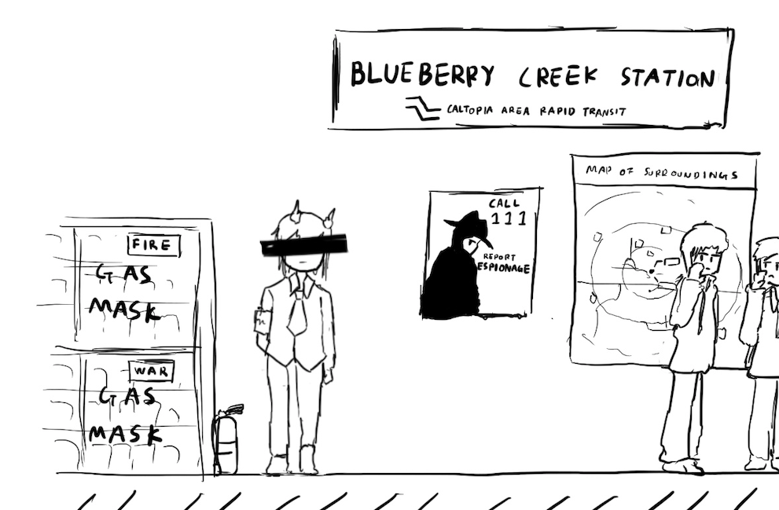
A Brief History of Cryptography
Textbook Chapter 5.2

Slide 58
Cryptography by Hand: Caesar Cipher
One of the earliest cryptographic schemes was the Caesar cipher
Used by Julius Caesar over 2,000 years ago
KeyGen():
Choose a key K randomly between 0 and 25
Enc(K, M):
Replace each letter in M with the letter K positions later in the alphabet
If K = 3, plaintext DOG becomes GRJ
Dec(K, C):
Replace each letter in C with the letter K positions earlier in the alphabet
If K = 3, ciphertext GRJ becomes DOG
K = 3
M | C | M | C
A | D | N | Q
B | E | O | R
C | F | P | S
D | G | Q | T
E | H | R | U
F | I | S | V
G | J | T | W
H | K | U | X
I | L | V | Y
J | M | W | Z
K | N | X | A
L | O | Y | B
M | P | Z | C

Slide 59
Cryptography by Hand: Attacks on the Caesar Cipher
Eve sees the ciphertext JCKN ECGUCT, but doesn’t know the key K
If you were Eve, how would you try to break this algorithm?
Brute-force attack: Try all 26 possible keys!
Use existing knowledge: Assume that the message is in English
+1 IBJM DBFTBS
+2 HAIL CAESAR
+3 GZHK BZDRZQ
+4 FYGJ AYCQYP
+5 EXFI ZXBPXO
+6 DWEH YWAOWN
+7 CVDG XVZNVM
+8 BUCF WUYMUL
+9 ATBE VTXLTK
+10 ZSAD USWKSJ
+11 YRZC TRVJRI
+12 XQYB SQUIQH
+13 WPXA RPTHPG
+14 VOWZ QOSGOF
+15 UNVY PNRFNE
+16 TMUX OMQEMD
+17 SLTW NLPDLC
+18 RKSV MKOCKB
+19 QJRU LJNBJA
+20 PIQT KIMAIZ
+21 OHPS JHLZHY
+22 NGOR IGKYGX
+23 MFNQ HFJXFW
+24 LEMP GEIWEV
+25 KDLO FDHVDU

Slide 60
Cryptography by Hand: Attacks on the Caesar Cipher
Eve sees the ciphertext JCKN ECGUCT, but doesn’t know the key K
Chosen-plaintext attack: Eve tricks Alice into encrypting plaintext of her choice
Eve sends a message M = AAA and receives C = CCC
Eve can deduce the key: C is 2 letters after A, so K = 2
Eve has the key, so she can decrypt the ciphertext

Slide 61
Cryptography by Hand: Substitution Cipher
A better cipher: create a mapping of each character to another character.
Example: A = N, B = Q, C = L, D = Z, etc.
Unlike the Caesar cipher, the shift is no longer constant!
KeyGen():
Generate a random, one-to-one mapping of characters
Enc(K, M):
Map each letter in M to the output according to the mapping K
Dec(K, C):
Map each letter in C to the output according to the reverse of the mapping K
K
M | C | M | C
A | N | N | G
B | Q | O | P
C | L | P | T
D | Z | Q | A
E | K | R | J
F | R | S | O
G | V | T | D
H | U | U | I
I | E | V | C
J | S | W | F
K | B | X | M
L | W | Y | X
M | Y | Z | H

Slide 62
Cryptography by Hand: Attacks on Substitution Ciphers
Does the brute-force attack still work?
There are 26! ≈ 2⁸⁸ possible mappings to try
Too much for most modern computers… for now
How about the chosen-plaintext attack?
Trick Alice into encrypting ABCDEFGHIJKLMNOPQRSTUVWXYZ, and you’ll get the whole mapping!
Another strategy: cryptanalysis
The most common english letters in text are E, T, A, O, I, N
K
M | C | M | C
A | N | N | G
B | Q | O | P
C | L | P | T
D | Z | Q | A
E | K | R | J
F | R | S | O
G | V | T | D
H | U | U | I
I | E | V | C
J | S | W | F
K | B | X | M
L | W | Y | X
M | Y | Z | H

Slide 63
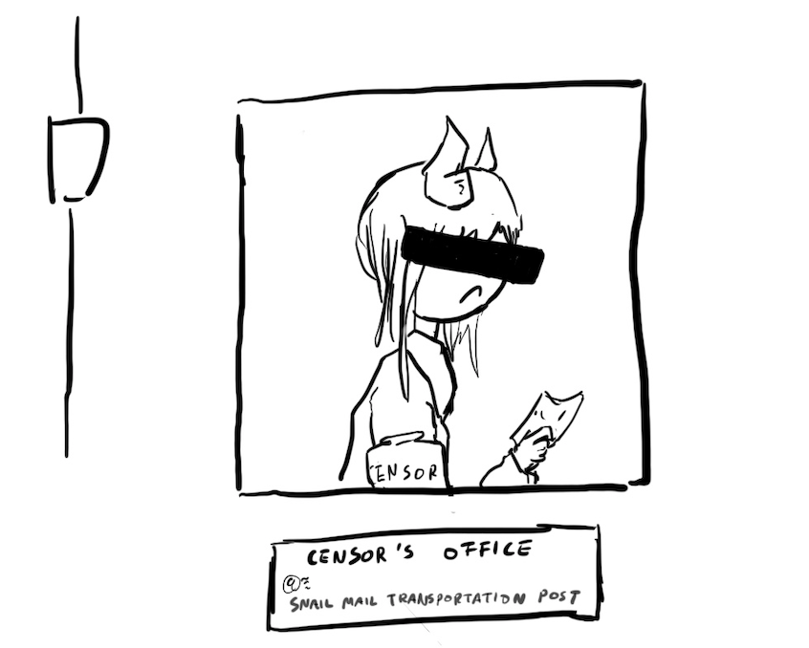
Takeaways
Cryptography started with paper-and-pencil algorithms (Caesar cipher)
Then cryptography moved to machines (Enigma)
Finally, cryptography moved to computers (which we’re about to study)
Hopefully you gained some intuition for some of the cryptographic definitions

Slide 64
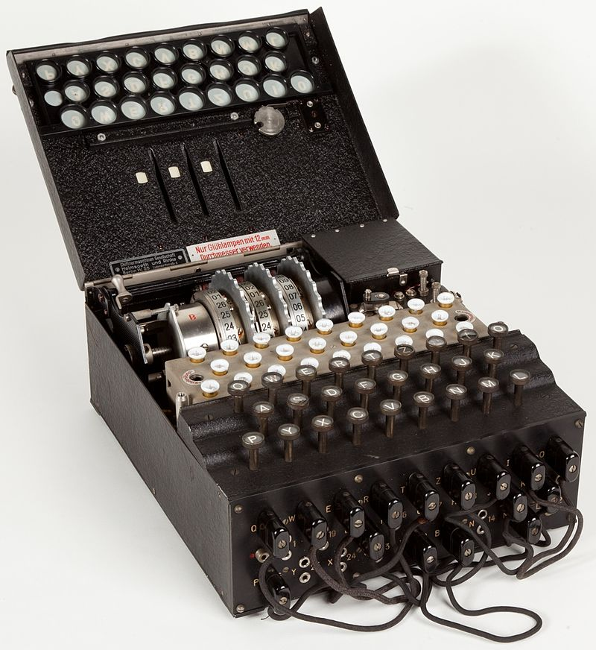
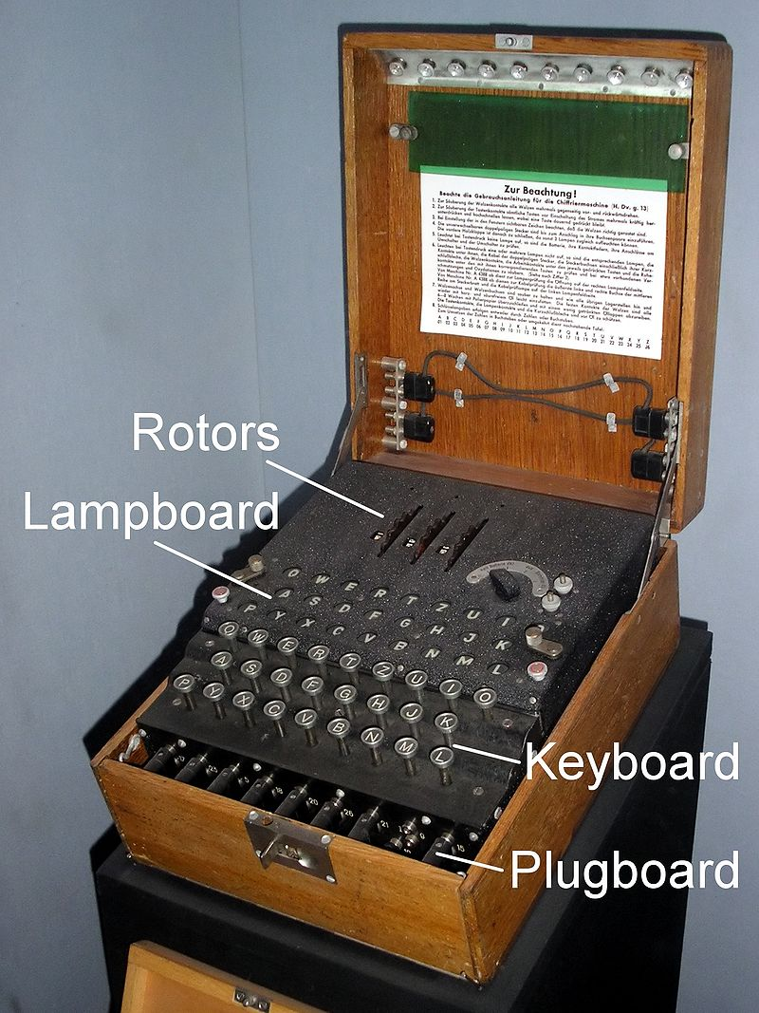
Cryptography by Machines: Enigma
A mechanical encryption machine used by the Germans in WWII
Rotors
Plugboard

Slide 65
Enigma Operating Principle: Rotor Machine
The encryption core was composed of 3 or 4 rotors
Each rotor was a fixed permutation (e.g. A maps to F, B maps to Q...)
And the end was a "reflector", a rotor that sent things backwards
Plus a fixed-permutation plugboard
A series of rotors were arranged in a sequence
Each keypress would generate a current from the input to one light for the output
Each keypress also advanced the first rotor
When the first rotor makes a full rotation, the second rotor advances one step
When the second rotor makes a full rotation, the third rotor advances once step

Slide 66
Cryptography by Machines: Enigma
KeyGen():
Choose rotors, rotor orders, rotor positions, and plugboard settings
158,962,555,217,826,360,000 possible keys
Enc(K, M) and Dec(K, C):
Input the rotor settings K into the Enigma machine
Press each letter in the input, and the lampboard will light up the corresponding output letter
Encryption and decryption are the same algorithm!
Germans believed that Enigma was an “unbreakable code”

Slide 67
Cryptography by Machines: Enigma
Eve (adversary)
Alice (challenger)
Enigma has a significant weakness: a letter never maps to itself!
No rotor maps a letter to itself
The reflector never maps a letter to itself
This property is necessary for Enigma’s mechanical system to work
What pair of messages should Eve send to Alice in the challenge phase?
Send M0 = A^{k}, M1 = B^{k}
M0 is a string of k 'A' characters, M1 is a string of k 'B' characters
How can Eve probably know which message Alice encrypted?
If there are no 'A' characters, it was M0
If there are no 'B' characters, it was M1
M
(repeat)
Enc(K, M)
M0 and M1
pick b
Enc(K, Mb)
M
(repeat)
Enc(K, M)
Guess b = 0 or b = 1

Slide 68
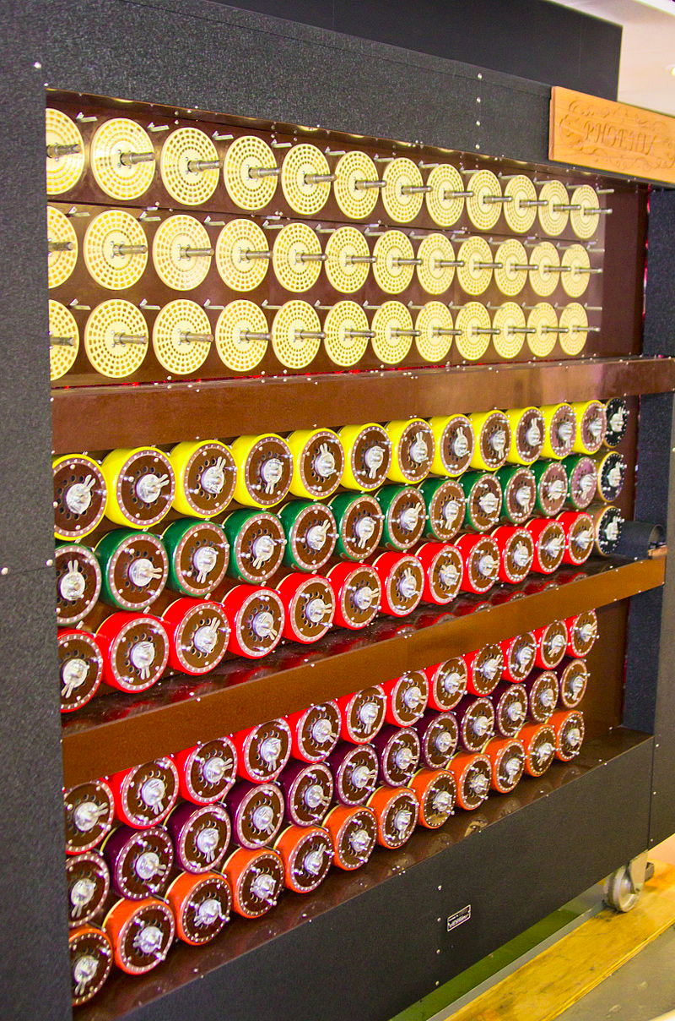
Cryptography by Machines: Attack on Enigma
Polish and British cryptographers built BOMBE, a machine to brute-force Enigma keys
Why was Enigma breakable?
Kerckhoff’s principle: The Allies stole Enigma machines, so they knew the algorithm
Known plaintext attacks: the Germans often sent predictable messages (e.g. the weather report every morning)
Chosen plaintext attacks: the Allies could trick the Germans into sending a message (e.g. “newly deployed minefield”)
Brute-force: BOMBE would try many keys until the correct one was found
Plus a weakness: You'd be able to try multiple keys with the same hardware configuration
BOMBE machine

Slide 69
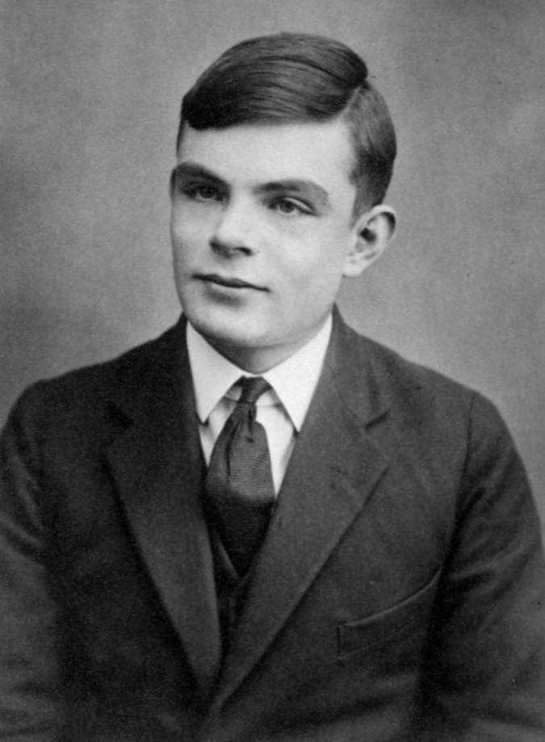
Cryptography by Machines: Legacy of Enigma
Alan Turing, one of the cryptographers who broke Enigma, would go on to become one of the founding fathers of computer science
Most experts agree that the Allies breaking Enigma shortened the war in Europe by about a year
Alan Turing

Slide 70
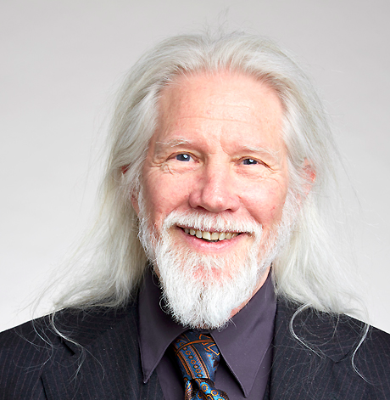

Cryptography by Computers
The modern era of cryptography started after WWII, with the work of Claude Shannon
“New Directions in Cryptography” (1976) showed how number theory can be used in cryptography
Its authors, Whitfield Diffie and Martin Hellman, won the Turing Award in 2015 for this paper
This is the era of cryptography we’ll be focusing on
One of these is Diffie, and the other one is Hellman.

